Slide 1

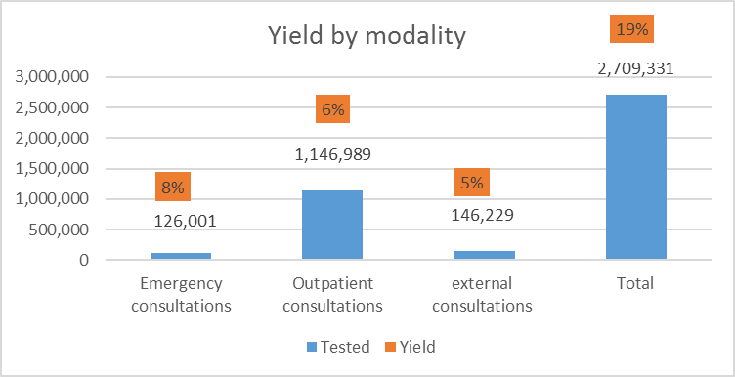



Integration of Screening Risk Behavior and Symptoms Suggestive of HIV Infection into National HIV Testing Services in Mozambique, 2019
Amane G ¹, Couto A ¹, Chicuecue N ¹, Sathane I ¹, Seleme J ¹, Khan S ¹
¹ National Program to Control STIs HIV/AIDS, MOH, Mozambique
Background
In April 2018, Mozambique has approved for implementation of DSD Guidelines.
The national DSD guides the implementation of Three Screening Risk Behavior and Symptoms Suggestive of HIV Algorithms, to ensure HIV testing for adults, adolescents and children which are really suggestive of being infected with HIV.
This approach avoids massive HIV testing by ensuring that testing providers implement focused HTS.
Methods
In March 2019, Mozambique started to implement the Screening Risk Behavior and Symptoms Suggestive of HIV Algorithms in specific HF services such as:
Emergency consultations, Outpatient and External consultations, to ensure HIV testing eligibility and focused identification of people living of HIV, for adults, adolescents and children at all public HTS facilities in Mozambique (N = 1,634).
Results
From April to December 2019, of 2,709,331 persons receiving HIV counseling and testing during this time:
126,001 were tested in Emergency consultations,
1,146989 were tested in Outpatient consultations and,
146,229 were testes in External consultations.
The proportion testing positive was highest in Emergency consultations (8%), Outpatient consultations with 6% and External consultations with 5% people tested positive.
Conclusions
Mozambique is one of the high HIV prevalence countries which implements Screening Risk Behavior and Symptoms Suggestive of HIV Algorithms, to ensure the eligibility for HTS of people who are truly at risk of being infected with HIV.
Data confirms that the implementation of this approach in the HTS services allows the identification of people living with HIV.
The use of screening algorithms also allows the HTS providers to not test for HIV all clients, ensuring quality of testing, psychosocial support, linkages and retention.
Image: Screening Risk Behavior and Symptoms Suggestive of HIV Algorithms
PRESENTED AT THE 23RD INTERNATIONAL AIDS CONFERENCE (AIDS 2020) | 6-10 JULY 2020

